Slide 1
AUTOMATIC GAS LEAKAGE DETECTOR WITH IOT AND MEASURING GAS LEVEL USING ESP8266.
DEPARTMENT OF COMPUTER SCIENCE AND ENGINEERING(CYBER SECURITY)
DOMAIN : INTERNET OF THINGS
BATCH NO:10
Presented
by
GUIDE NAME :

Slide 2
AIM
The Primary objective of the project is to Detect the Gas Leakage Of LPG Cylinders, which are commonly used in India.
In homes-Alarm the user and the surrounding neighborhood using iot.
The Supply gas will also be stopped with the use of solenoid, ultimately preventing the chance of accident.

Slide 3
ABSTRACT
LPG is currently used in all segment including domestic, agriculture and industrial.
It is proved as one of the most cost-effective and less polluting fuels for domestic applications.
IoT helping in automating tasks and the benefits of IoT can also be extended for enhancing the existing safety standards.
The Main Objective of the project is to build a gas leakage detector using LPG gas sensor and also connect it with IoT using ESP8266 module for safety and security.

Slide 4
LITERATURE SURVEY
TITLE: SMART AND RELIABLE LPG REGULATOR DESIGN USING INTERNET OF THINGS .
YEAR: 2017
AUTHOR NAME : Neethu Narayan , Anusree,et.al
DESCRIPTION:
Many incidents of accidents related to LPG have been presented in literature. Analysis of LPG accidents, creating a fireball and BLEVE situation in the LPG tank with following fire and explosion
Detailed assessment of explosive LPG leakage accidents, along with model for prediction of such accidents. It was shown that the major uncertainty is associated with the estimation of the force involved in the physical expansion of the liquid after a pool fire, to a fireball and to the tragic rupture of the cylinder.
For a LPG explosion produced in an enclosure with a vent, main hazards, within the vent, are overpressure and high temperature.
DISADVANTAGES:
Depends upon the Humidity and Temperature.
High Cost and maintenance .

Slide 5
LITERATURE SURVEY
TITLE: IOT BASED SMART GAS MONITORING SYSTEM .
YEAR: 2019
AUTHOR NAME : V.P.Krishna Anne,R.Chaitainya ,Et.Al
DESCRIPTION:
In the proposed system, We have designed “IOT based Smart Gas Monitoring System”. This proposed system aims to detect the economic fuels like petroleum, liquid petroleum gas, alcohol etc and allows a provision for controlling the gas leakage by closing the valve automatically.
The next feature of the topic is to ensure the booking of gas cylinder from gas agency. For both the functioning the sensors detect the leaked gas from the sensor and send it to the internet .by programming on the internet, the sensed signal is directed to the android app by using the android app we give the signal for switching off gas valve from distant place.
The burner is left on by mistake, the consumer could be alerted about the problem. If the burner is on and there is no vessel on top of it, an alarm goes off.
DISADVANTAGES:
No prevention of fires possible with kit.
Applicable only as an indicator/alarming device.
It works only when at 5V power supply is given.
Its sensitivity depends on Humidity and temperature.
It is a little sensitive to smoke

Slide 6
LITERATURE SURVEY
TITLE:SMART GAS BOOKING AND LPG LEAKAGE DETECTION SYSTEM.
YEAR : 2017
AUTHOR NAME : A. MAHALINGAM et.al,
DESCRIPTION:
In this paper, A. MAHALINGAM et.al, “Design and Implementation of an Economic Gas Leakage Detector”.
This project developed system to detect the gas leakage and providing immediate alarm or intimation to the user, few people developed the design proposed for home safety, This system detects the leakage of the LPG and alerts the consumer about the leak by buzzer.
This project was developed using microcontroller ARM version 7 processor and simulated using Kiel software.
DISADVANTAGES:
Gas sensor should be high enough sensitive to detect gas leakage.
If we can use another sensor then cost will be high.

Slide 7
LITERATURE SURVEY
TITLE:IOT BASED INDUSTRIAL PLANT SAFETY GAS LEAKAGE DETECTION SYSTEM.
YEAR:2018
AUTHOR NAME : S.Kayalvazhi ,et.al
DESCRIPTION:
In this paper, Traditional Gas leakage detection approaches fall under two categories:1) fixed instrumentation and 2) mobile sensing . In fixed instrumentation, sensors are appended in regions 2018 These instruments normally require consistent power source and generate alerts in light of their inspected information.
Estimated reports are transferred progressively either through a remote association or by coordinate correspondence between the specialist and other plant representatives. Specifically, a fixed sensor can persistently screen a region, rather than a laborer who tests a similar district for a couple of moments. As our proposed solution is static, we are interested in fixed sensors.
DISADVANTAGES:
The initial cost may be enough to deter you from pursuing this option, but consider what type of business you run.
It has to be planted throughout the Gas leakage area.

Slide 8
LITERATURE SURVEY
TITLE: GAS LEAKAGE DETECTION WITH AUTOMATIC BOOKING & VALVE BYPASS.
YEAR :2018.
AUTHOR NAME : Sethulakshmi Prasad,et.al,
DESCRIPTION :
In this paper, GSM based gas leakage detection system in year 2014. Ashish Srivastava, et al. The paper focus on Real time gas monitoring system, LPG Gas detection and prevention of leakage gas.
LPG Gas Weight and Leakage Detection System device will help to book the new cylinder by using GSM module, We came to know that it has use GSM & leakage detection.
DISADVANTAGES:
It can be installed at a specific point of detection for a specific gas leak for 24 hours of continuous detection.
The instrument needs to be connected to the power supply to work, not easy to move, and the use of the environment

Slide 9
LITERATURE SURVEY
TITLE :HAZARDOUS GAS DETECTION USING ARDUINO.
YEAR: 2016.
AUTHOR NAME : Asmita Varma .G, Prabakar .S ,et.al
DESCRIPTION :
In this paper ,the functionality of system is divided into three main steps, In the initial step, the gas leakage is detected by the gas sensor. This detects the gas leakage and gives the signal to the microcontroller.
After that in second step the microcontroller receives the signal, which sends by gas sensor. It sends activation signal to other external devices attached such as LCD display .
The LCD display will show which gas is actually detected.
DISAVANTAGES:
The greater the exposure to the target gas, the shorter the life span.
Cross-sensitivity of other gases.

Slide 10
EXISTING SYSTEM
The Existing method takes an automatic control action upon detection of gas , The regulator valve would be switched off which completely stops the flow of gas leakage.
This High signal is monitored by the microcontroller and it will identify the gas leakage.
If there is a leakage, the consumer is informed through internet in his device and a signal is sent back to the microcontroller to turn off the valve.
The Object detection sensor is used to detect the presence of any vessel over the burner. If a vessel is not detected over a predetermined time, then an alarm goes off and the consumer is alerted.

Slide 11
DISADVANTAGES
In Existing system , The system works only when 5v is given.
Its sensitivity depends upon the temperature and humidity.
The Existing system made of high cost and more components to detect the gas leakage.
Cannot be used in Co and CO2 gases and produced the functions in this area.

Slide 12
PROPOSED SYSTEM
The Ultimate aim of the project is to make A finished product of gas leakage detection system for household.
With the advancement of Internet in Homes, The safety can be further increased with introduction of internet of things.
The product consists of outer wooden casing in shape of A box to carry the ARDUINO controller, solenoid, MQ5 gas sensor, ESP WI-FI module and A buzzer.
The Mouth of the sensor is placed right above the mouth of cylinder and the pipeline, A solenoid is placed such A way that whenever ,there is signal, it will close the pipe to stop the flow of gas.

Slide 13
ADVANTAGES
Sensors take the accurate value.
It is used as in-house LPG gas leakage detector.
In the long run, The Maintenance cost is very less compared to existing system.
Less Complex Circuit.
Cost –Efficient .
No Environmental Effect or no effect of physical accidents.

Slide 14
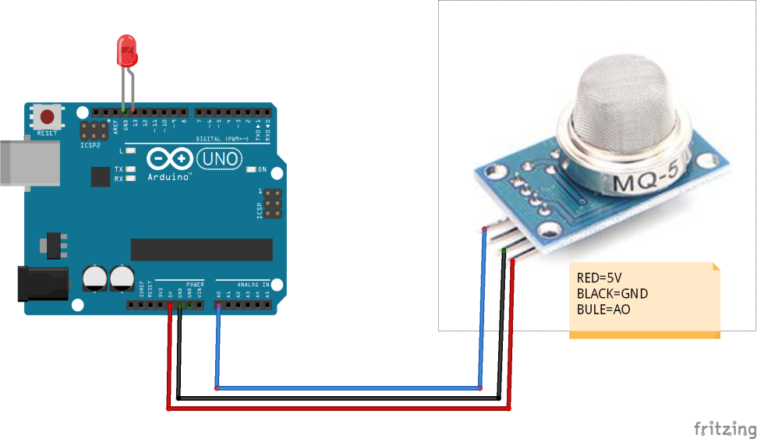
GAS SENSOR DESCRIPTION
We are using the MQ5 gas sensor module.
A analog out (A0) and a digital out (D0). The analog out can be used to detect gas leakage and to measure volume of gas leakage in specific units (ppm).
The digital out can be used to detect gas leakage and hence trigger an alert system
The digital out gives only two possible outputs – High and Low hence its more suited for detection of gas leak than to measure volume of gas presence.
MQ 5 SENSOR

Slide 15
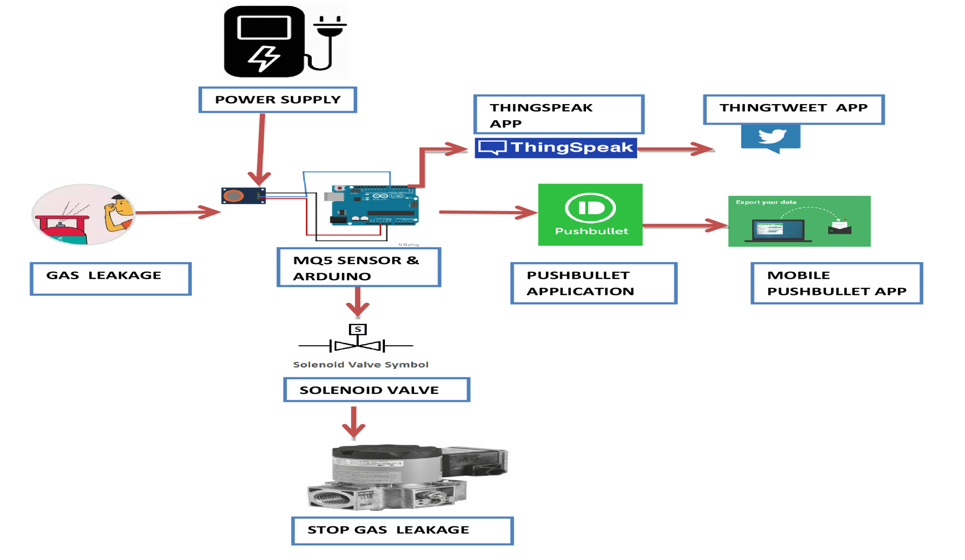
ARCHITECTURE DIAGRAM
ARCHITECTURE DIAGRAM OF THE PROJECT

Slide 16
MODULES
DETECTION PHASE
ALERTING PHASE
PREVENTION PHASE

Slide 17
MODULE DESCRIPTION
DETECTION PHASE:
The Basic principle of the working of Gas leakage detection alarm is that the gas sensor senses the leakage and triggers the buzzer.
A Gas detector is a device that detects the presence of gases in an area, often as part of a safety system.
This type of equipment is used to detect gas leakage and thus interface with a control system in turn the process will shutdown gas automatically.

Slide 18
MODULE DESCRIPTION
ALERTING PHASE:
1.THING SPEAK:
Thing Speak channels store and upload data from the web or send data from devices to a Thing Speak channel.
To transform and visualize data or trigger an action.
2.PUSHBULLET:
Push bullet service for sending files, URL links, lists, addresses and anything you can think of to various contacts on a multitude of platforms.

Slide 19

MODULE DESCRIPTION
PREVENTION PHASE:
A Solenoid valve is basically an automatic valve which is electrically operated and thus removes the need for any other person to operate this valve manually.
A Solenoid Valve plays an important role, shutdowns the valve automatically.
The Basic working principle of all the Solenoid valves is exactly the same where as the type and size are different.
SOLENOID VALVE

Slide 20
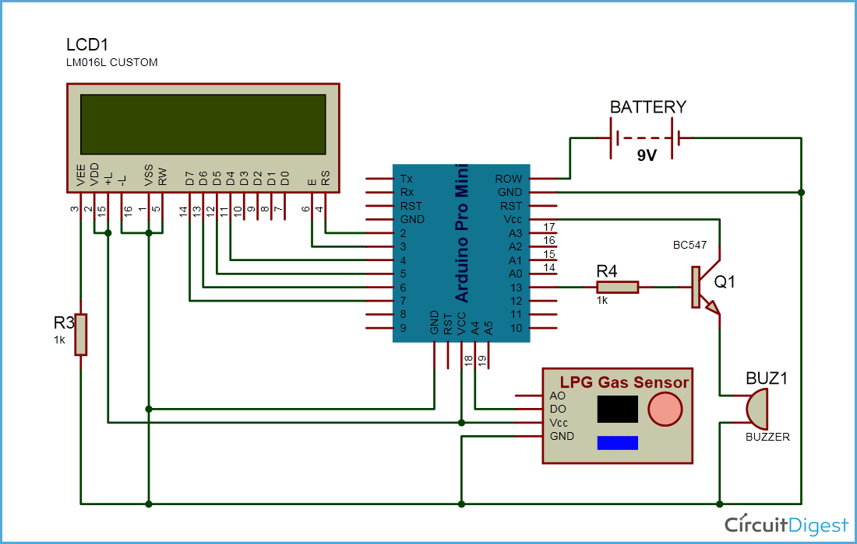
CIRCUIT DIAGRAM

Slide 21
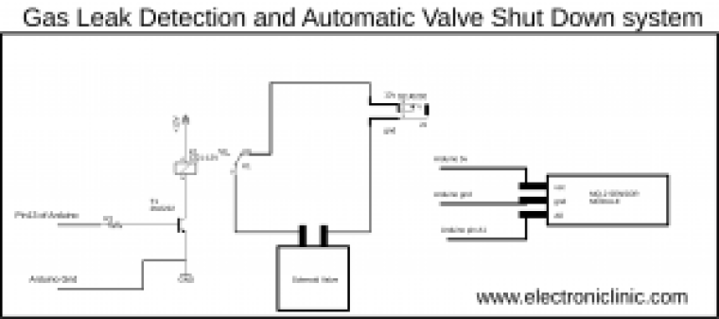
CIRCUIT DIAGRAM
CIRCUIT DIAGRAM

Slide 22
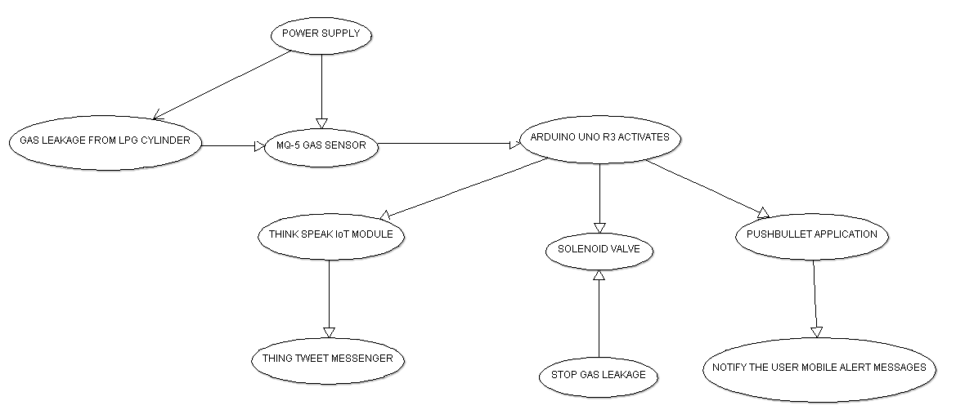
USE CASE DIAGRAM

Slide 23
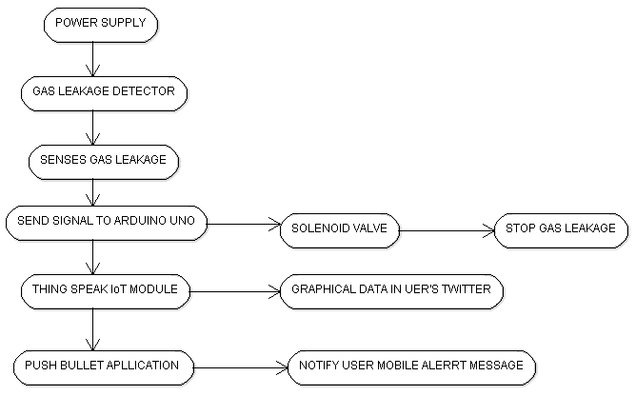
ACTIVITY DIAGRAM

Slide 24
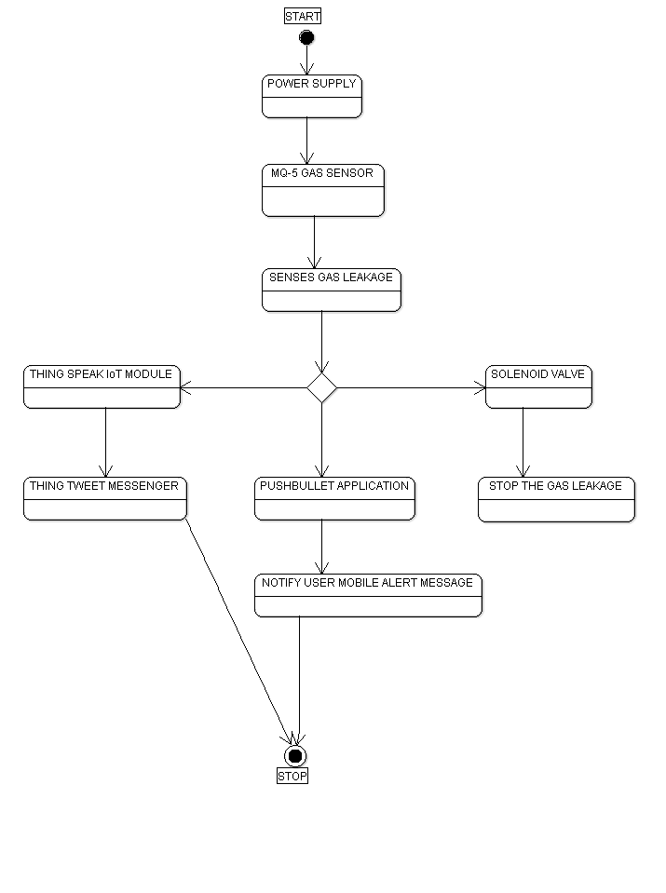
STATE DIAGRAM

Slide 25
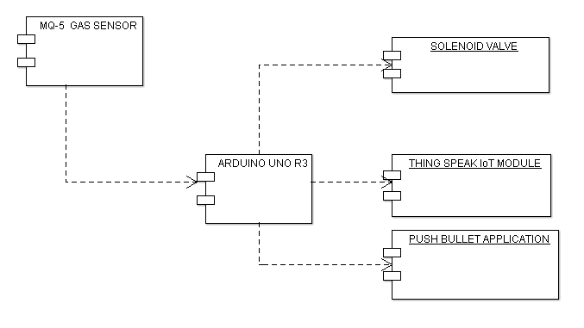
COMPONENT DIAGRAM

Slide 26
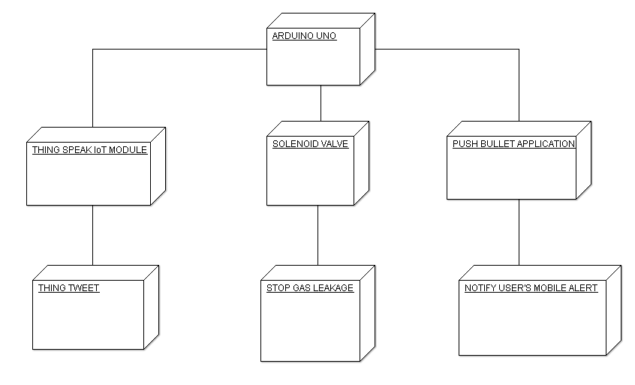
DEPLOYMENT DIAGRAM

Slide 27
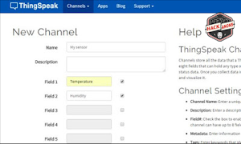
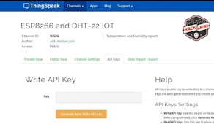
SOFTWARE SCREENSHOTS
Click on the new channel give it a name and select two fields. If you want you can fill more info about your channel.
If you want to share sensor info with your friends Click on the Make Public Check box option.
Finally click on the Save channel button.

Slide 28
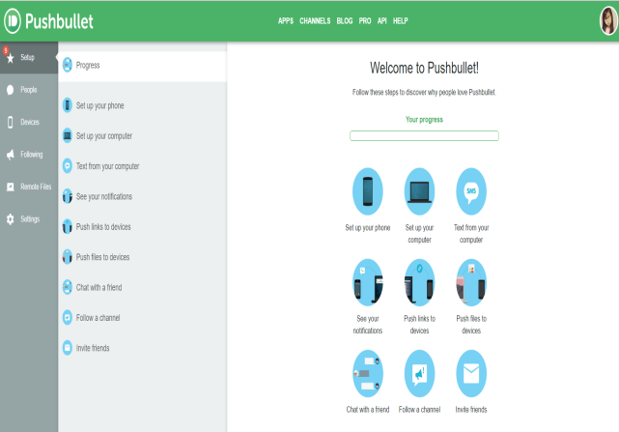
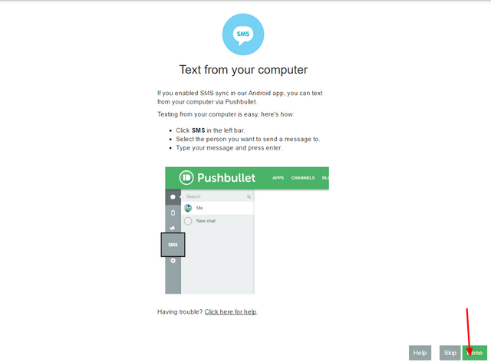
SOFTWARE SCRENSHOTS
Push Bullet is one of the fastest and easiest way to get links, notes, lists, files, and addresses both from your desktop computer to your mobile device and vice versa. All of this is done from the Push bullet Android app.

Slide 29
PROGRAM-1
#include <SoftwareSerial.h>
SoftwareSerial espSerial = SoftwareSerial(2,3);
float sensor=A0;
float gas_value;
String apiKey = "5G0NEIEWV7FQWERTY";
String ssid=" ";
String password =" ";
boolean DEBUG=true;

Slide 30
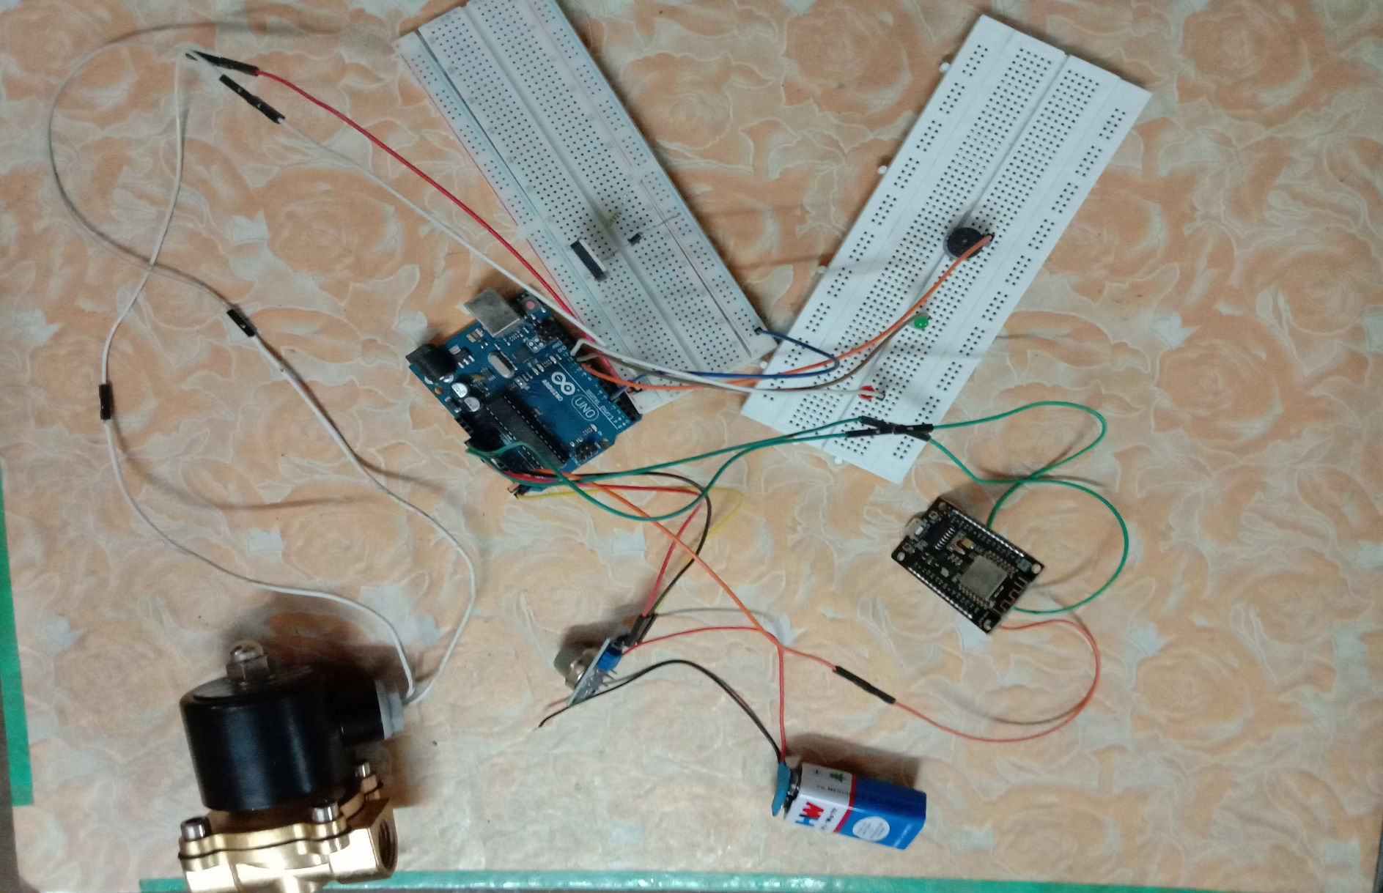
HARDWARE SNAPSHOT

Slide 31
PROGRAM-1
#define VOLTAGE_MAXCOUNTS 1023.0
void showResponse(int waitTime)
{
long t=millis();
char c;
while (t+waitTime>millis())
{
if (espSerial.available())
{
c=espSerial.read();
if (DEBUG) Serial.print(c);
}
}
}

Slide 32
PROGRAM-1
boolean thingSpeakWrite(float value1){
String cmd = "AT+CIPSTART=\"TCP\",\"";
cmd += "184.106.153.149";
cmd += "\",80";
espSerial.println(cmd);
if (DEBUG) Serial.println(cmd);
if(espSerial.find("Error")){
if (DEBUG) Serial.println("AT+CIPSTART error");
return false;}

Slide 33
PROGRAM-1
String getStr = "GET /update?api_key=";
getStr += apiKey;
getStr +="&field1=";
getStr += String(value1);
getStr += "\r\n";
cmd = "AT+CIPSEND=";
cmd += String(getStr.length());
espSerial.println(cmd);

Slide 34
PROGRAM-1
if (DEBUG) Serial.println(cmd);
delay(100);
if(espSerial.find(">")){
espSerial.print(getStr);
if (DEBUG) Serial.print(getStr);
}
else{
espSerial.println("AT+CIPCLOSE");
if (DEBUG) Serial.println("AT+CIPCLOSE");
return false;
}

Slide 35
PROGRAM-1
return true;
}
void setup() {
DEBUG=true;
pinMode(LED_BUILTIN, OUTPUT);
pinMode(sensor,INPUT);
Serial.begin(9600);
espSerial.println("AT+CWMODE=1");
showResponse(1000);

Slide 36
PROGRAM-1
espSerial.println("AT+CWJAP=\""+ssid+"\",\""+password+"\"");
showResponse(5000);
if (DEBUG) Serial.println("Setup completed");
}
void loop() {
gas_value=analogRead(sensor);
Serial.println(gas_value);
delay(1);
if(gas_value>250){
digitalWrite(LED_BUILTIN, HIGH);

Slide 37
PROGRAM-1
float t = gas_value*(VOLTAGE_MAX / VOLTAGE_MAXCOUNTS);
if (isnan(t)) {
if (DEBUG) Serial.println("Failed to read from MQ5");
}
else{
if (DEBUG) Serial.println("Voltage="+String(t));
thingSpeakWrite(t);
}
delay(20000);
}
else{
digitalWrite(LED_BUILTIN, LOW);
}
}

Slide 38
PROGRAM-2
#include <LiquidCrystal.h> LiquidCrystal lcd(3, 2, 4, 5, 6, 7);
#define lpg_sensor 18 #define buzzer 13
void setup() { pinMode(lpg_sensor, INPUT); pinMode(buzzer, OUTPUT); lcd.begin(16, 2); lcd.print("LPG Gas Detector"); lcd.setCursor(0,1); lcd.print("Demo Execution"); delay(2000); }

Slide 39
PROGRAM-2
void loop() { if(digitalRead(lpg_sensor)) { digitalWrite(buzzer, HIGH); lcd.clear(); lcd.print("LPG Gas Leakage"); lcd.setCursor(0, 1); lcd.print(" Alert "); delay(400); digitalWrite(buzzer, LOW); delay(500); }

Slide 40
PROGRAM-2
else { digitalWrite(buzzer, LOW); lcd.clear(); lcd.print(" No LPG Gas "); lcd.setCursor(0,1); lcd.print(" Leakage "); delay(1000); } }

Slide 41
PROGRAM - 3
int smokeS = A1;
int data = 0;
int Svalve = 13;
void setup()
{
Serial.begin(9600);
pinMode(smokeS, INPUT);
pinMode(Svalve, OUTPUT);
digitalWrite(Svalve, LOW);
}

Slide 42
PROGRAM - 3
void loop()
{
data = analogRead(smokeS);
Serial.print("Gas leakage: ");
Serial.println(data);
if (data >= 230)
{
digitalWrite(Svalve, HIGH);
delay(500);
while(1)
{ Serial.println("Reset Controller: ");
delay(1000); }}
else
delay(1000); }

Slide 43
CONCLUSION AND FUTURE ENCHANCEMENT
The Automation of Gas leakage detection using IOT have the best solution by detecting automatically and alerts the user and neighbour about the leakage of gas using gas sensors.
The Application of this project into real time results in avoiding the gas cylinder explosion by preventing the gas leakage with closing the gas valve automatically.
In Future ,It can further extended with long distance sensor which can be installed in Industries, apartments, hotels and wherever it is needed.

Slide 44
REFERENCE
Anandhakrishnan S, Deepesh Nair, Rakesh K, Sampath K, Gayathri SNair, “IOT Based Smart Gas Monitoring System”, IOSR Journal of Electricaland Electronics Engineering (IOSR-JEEE), e-ISSN: 2278-1676, p-ISSN:2320-3331, PP 82-87, www.iosrjournals.org.
[2] Vinayak V. Mane, Shreyas S. Madhekar, Anand S. Kulkarni, Prof. VishalKatekar, “Gas Leakage Detection with Automatic Booking & Valve Bypass”,International Research Journal of Engineering and Technology (IRJET), e-ISSN: 2395-0056, p-ISSN: 2395-0072, Volume 05, Issue, 04 | Apr-2018,www.irjet.net.
[3] Kumar Keshamoni, Sabbani Hemanth, “Smart Gas Level Monitoring,Booking & Gas Leakage Detector over IoT”, 2017 IEEE 7th InternationalAdvance Computing Conference.
Selvapriya C, Sathya Prabha S, Abdulrahim M, Aarthi K C, ‘LPG Leakage Monitoring and Multilevel Alerting System’, International JournalOf Engineering Sciences & Research Technology, ISSN: 2277-9655,2(11): November, 2013.
[2] AravindaBeliraya, ‘GSM Based Gas Leakage Detection System Using Arduino’, International Journal of Engineering Technology Science andResearch, ISSN 2394 – 3386, Volume 4, Issue 10, October 2017.
[3] Prof. K.R.Katole ‘Hazardous Gas Detection using ARDUINO’, International Journal of Science Technology & Engineering, ISSN (online):2349-784X, Volume 2, Issue 10, April 2016.
[4] T.Soundarya, J.V. Anchitaalagammai, G. Deepa Priya, S.S. Karthick kumar, ‘C-Leakage: Cylinder LPG Gas Leakage Detection for Home
Safety’, IOSR Journal of Electronics and Communication Engineering (IOSR-JECE) e-ISSN: 2278-2834,p- ISSN: 2278-8735.Volume 9, Issue

Slide 45

“THANK YOU”

